Slide 1
Curiculum Vitae
Name : Yoga Wicaksono
Class : Fotografi 3b
NIM : 17610033

Slide 2
What is CV ?
CV is a written overview of a person's experience and other qualifications for a job opportunity.

Slide 3
Where is CV use ?
CV sent to organizations, companies, even someone

Slide 4
When do we write CV ?
We write a cv when we want to seeking a job applicant

Slide 5
Why do we write CV ?
So basically CV is the first opportunity you get to make a good impression on a potential company

Slide 6
Who can write CV ?
everyone who wants to find a job

Slide 7
How to make CV ?
Create the format for your CV.
List your name, address, telephone number, and email at the top of the page.
Write a personal profile
Create a section for your education and qualifications
Create a section for your work experience.
Create a section for your skills and achievements
Create a section for your interests
Create a section for other information

Slide 8
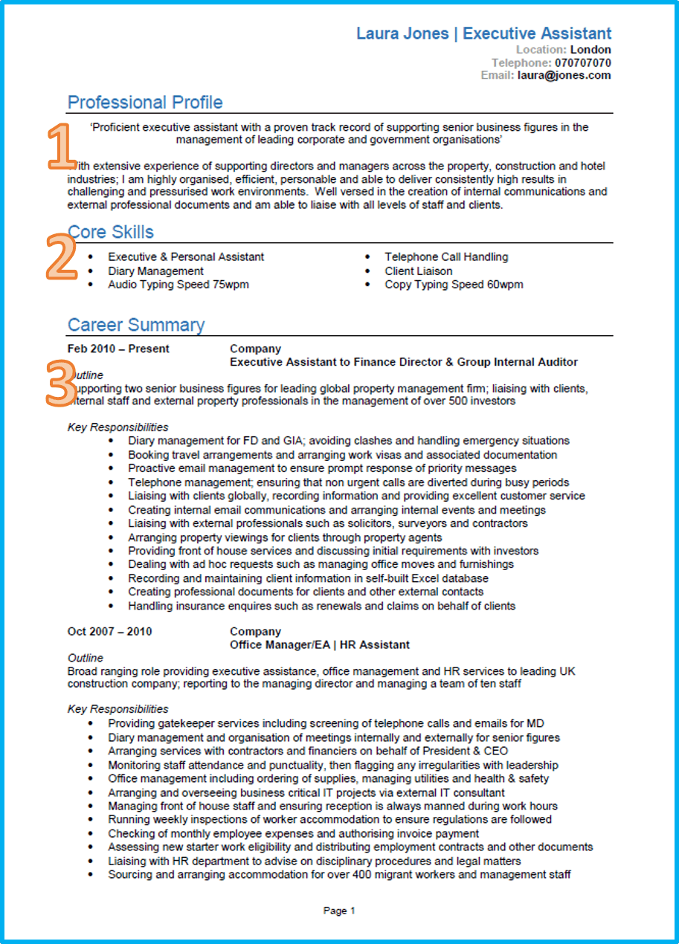
CV UK

Slide 9
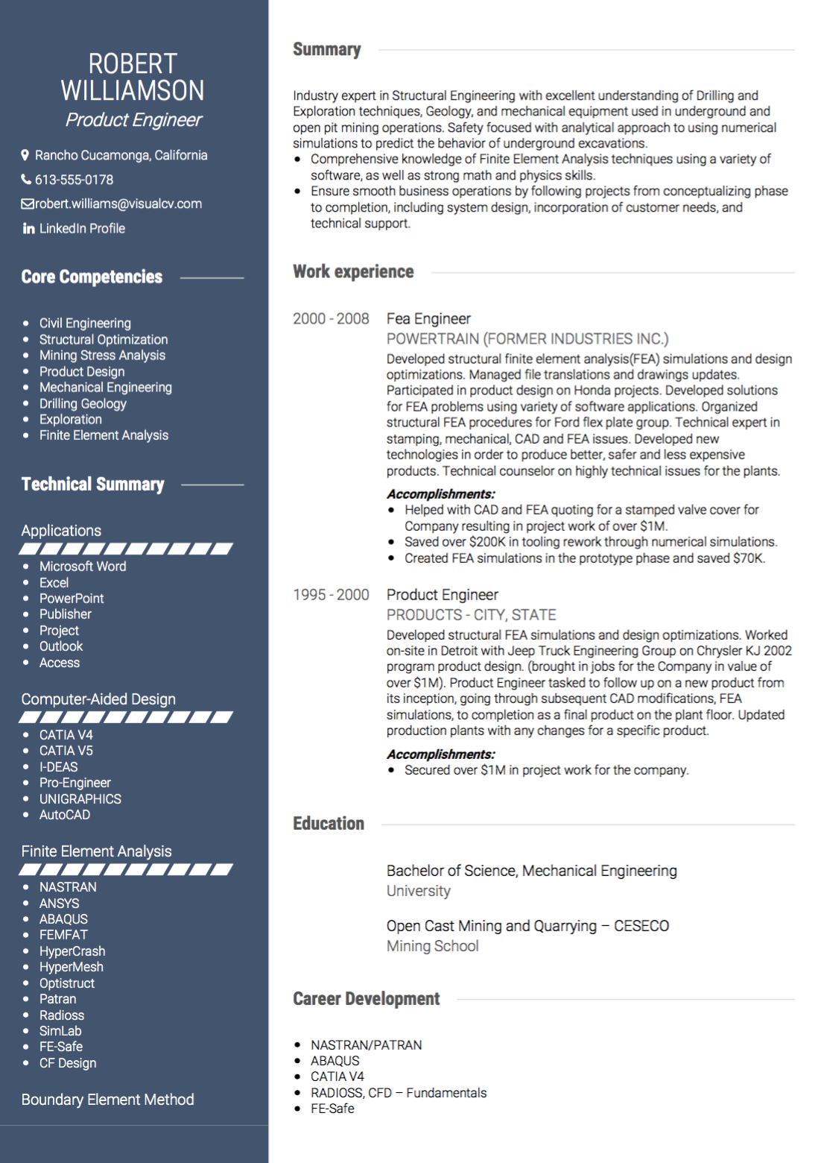
CV USA

Slide 10
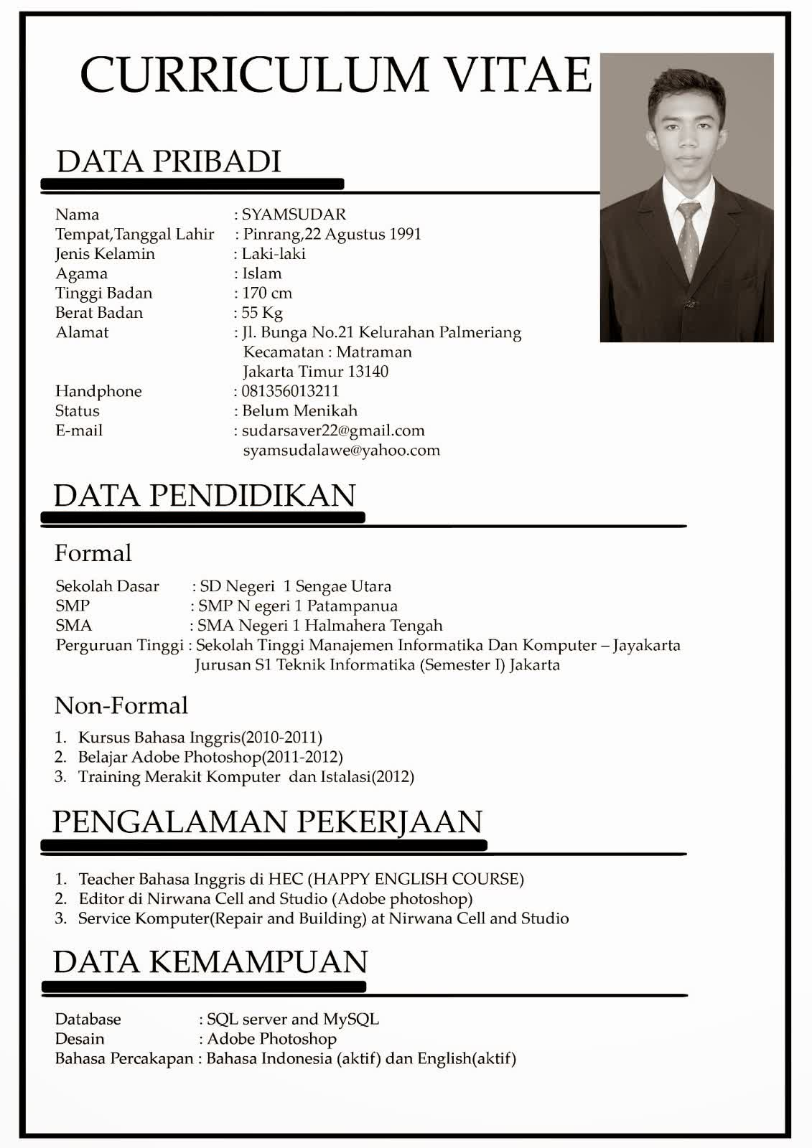
CV Indonesia

